Slide 1
" Beacon Hospital Sepsis Management Implementation Journey”
Beacon Hospital
Sandyford
Dublin 18

Slide 2
Contents
Sepsis National Concern
How our Journey Began
Staff Educational Tools
Results
Future Plans

Slide 3
Sepsis – A National Concern
National High-Profile Cases
Hospital Case Reviews
Development of National Guidelines following high-profile cases
Quality & Open Disclosure
Formatted weekly multidisciplinary forum – Patient Safety Committee

Slide 4
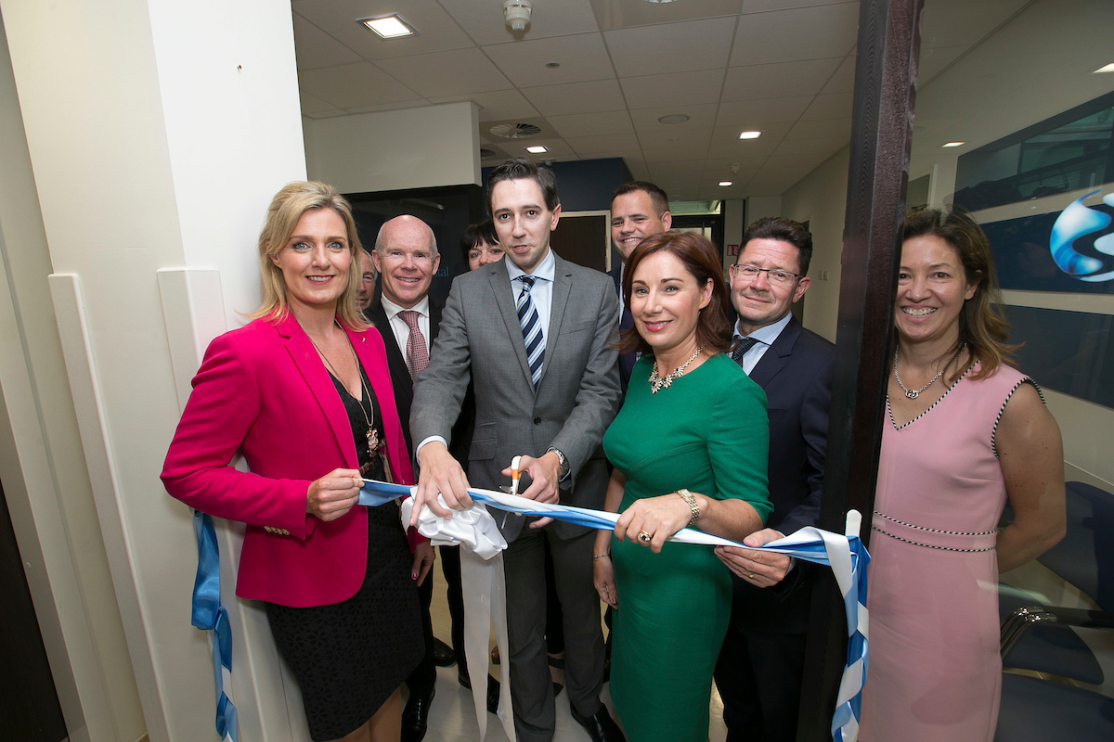
How Did the Journey Begin?
Beacon Hospital
JCI accredited
183 Bed, private Hospital
1.55% HCAI infection rate
Busy Emergency department Servicing National & Local Referrals
Diverse Range of Specialties
Surgical & Medical
Orthopaedics
Cardiothoracic
Colorectal
Oncology Programme
New Urology & Endoscopy Departments

Slide 5
Quality, Patient Safety and Sepsis
Journey made easier due to already established communication tools regarding deteriorating patients
R.S.V.P = Reason, Situation, Vitals, Plan
ALERT Team = Alerts necessary team members
Strong culture of Quality and Patient Safety
Risk management
Case reviews and RCA’s, conducted & evaluated by MDT to improve patient care

Slide 6
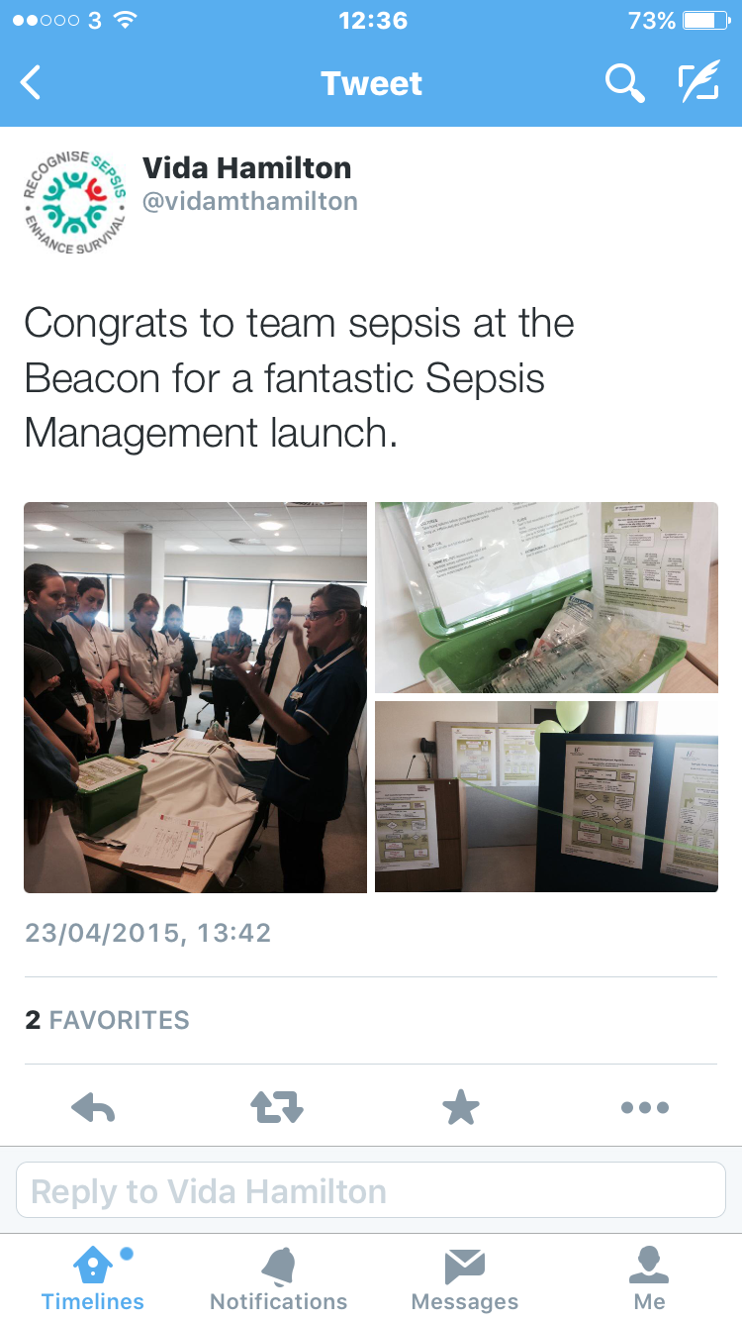
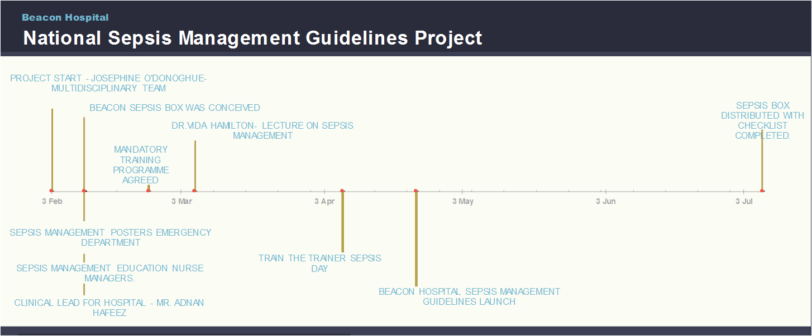
Initiation of the Sepsis Project
Consultant Clinical Lead appointed
Staff Education
ED, nurse managers
Mandatory Training Implemented
Online (Moodle)
Orientation
Category 1 Approval for In-House Education (Valid 2 yrs)
PDSA and Lean Methodology Used
Train the Trainer
Vida Hamilton Presentation
Sepsis Box Launched
Launch of the Sepsis Guidelines
April 2015

Slide 7
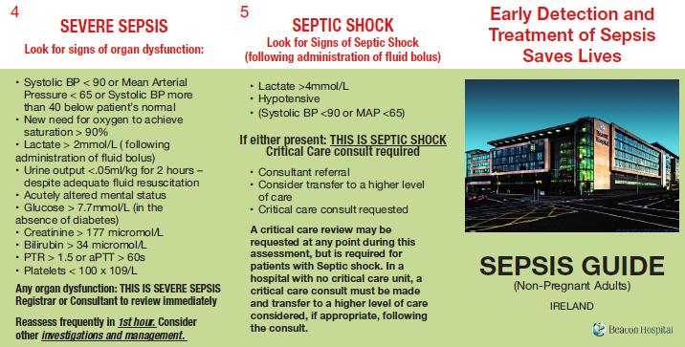
Sepsis Educational Tools
Staff Lanyard Card
Moodle Online Education
Staff Information Card

Slide 8
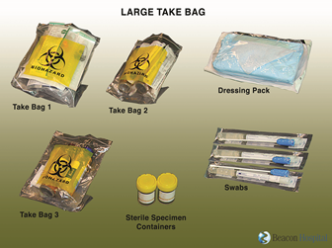
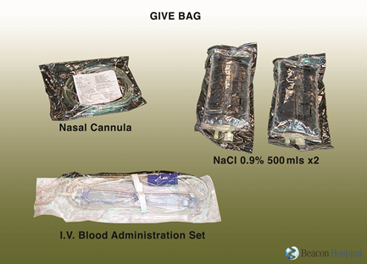
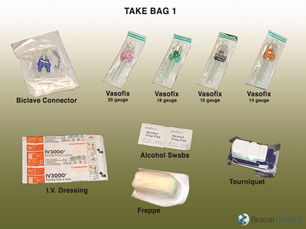
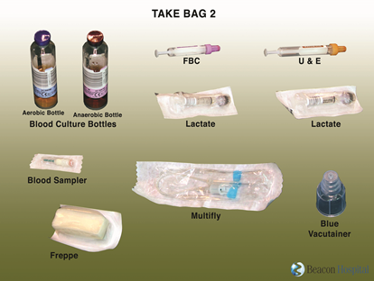
Sepsis Box

Slide 9
Reporting of Sepsis
Nurses & Doctors Complete the Sepsis Audit Tool
Give 3, Take 3
Scanning of Forms
Data Analysis
Reporting
All printers are scan enabled - Forms scanned directly into “National Sepsis Guidelines” folder for analysis
Ward staff educated in method of scanning

Slide 10
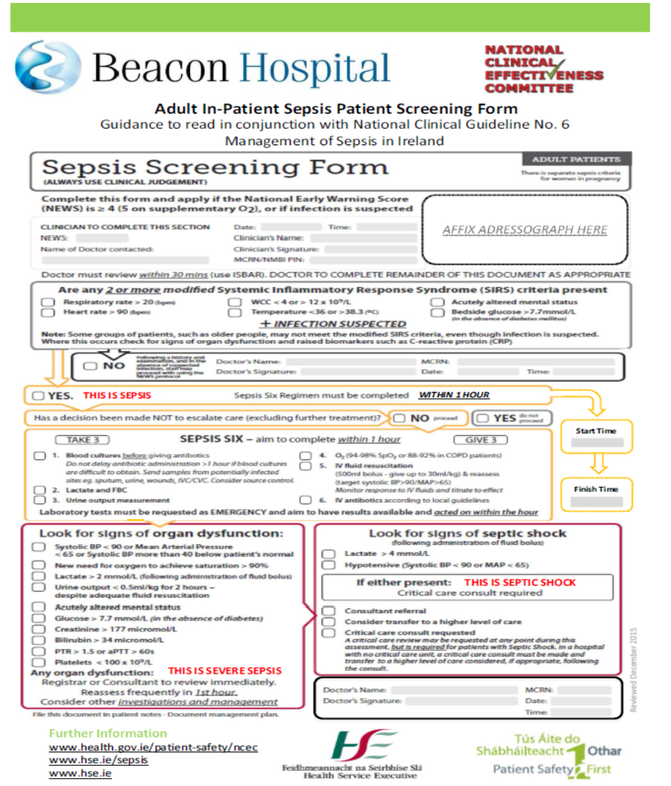
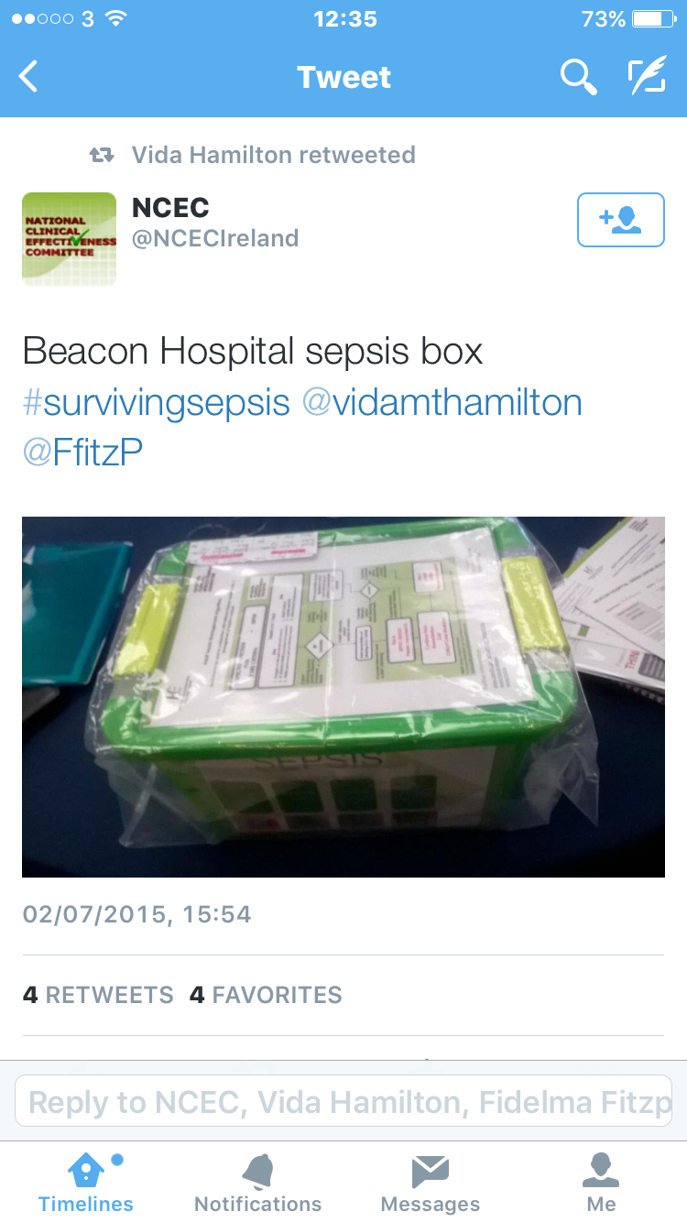
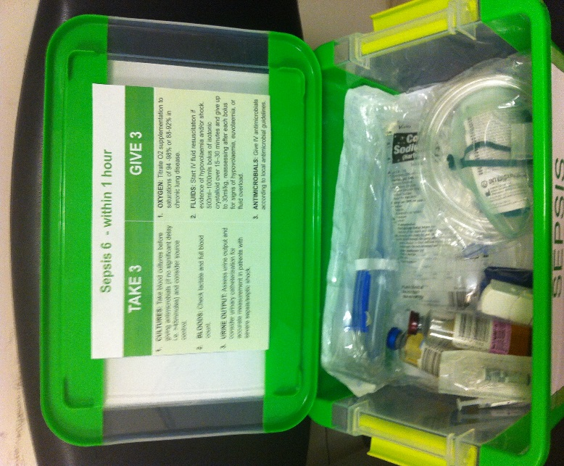
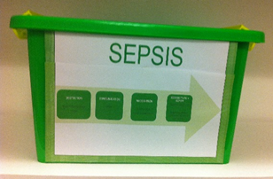
Challenges of the Journey
Designing the Sepsis Box and check-list
Everything necessary for “Give 3, Take 3”
National Sepsis Forms
Coding – ongoing challenge
Added Sepsis, Severe Sepsis, Septic Shock
Scanning of Forms
Ward Staff Training

Slide 11
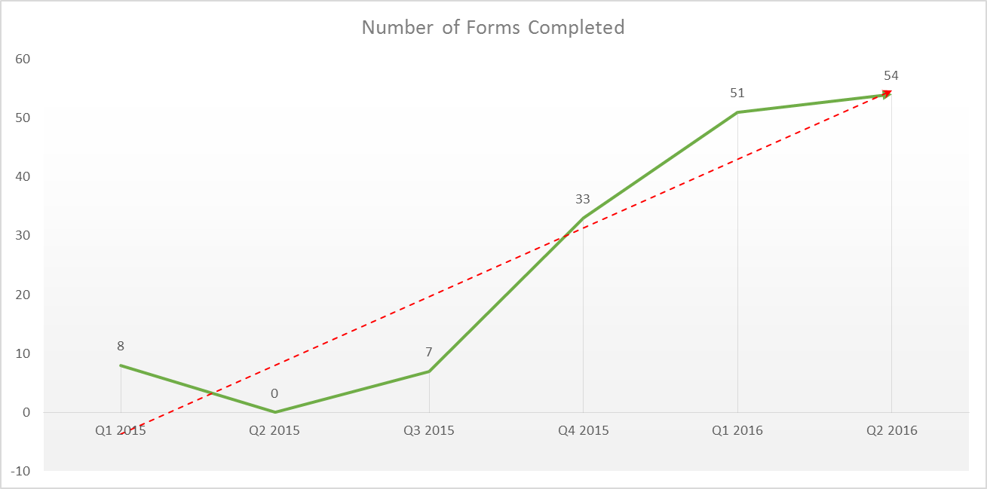
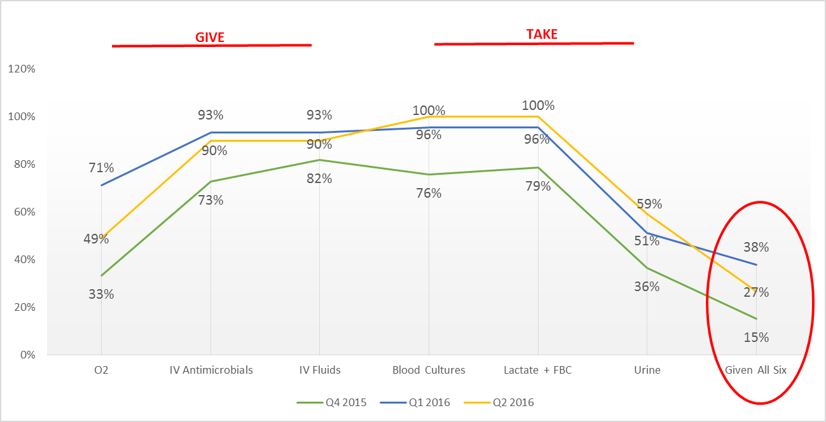
Results Thus Far
There has been a consistent increase in the number of forms completed each quarter
Within in the past 12 months we have seen an increase from 0 forms filled & scanned, to 54 in Q2 2016
Compliance with giving all of the Sepsis 6 remains about 25% within the first 2 quarters of 2016
We also had 100% compliance with taking Blood Cultures and Lactate & FBC in Q2 2016

Slide 12
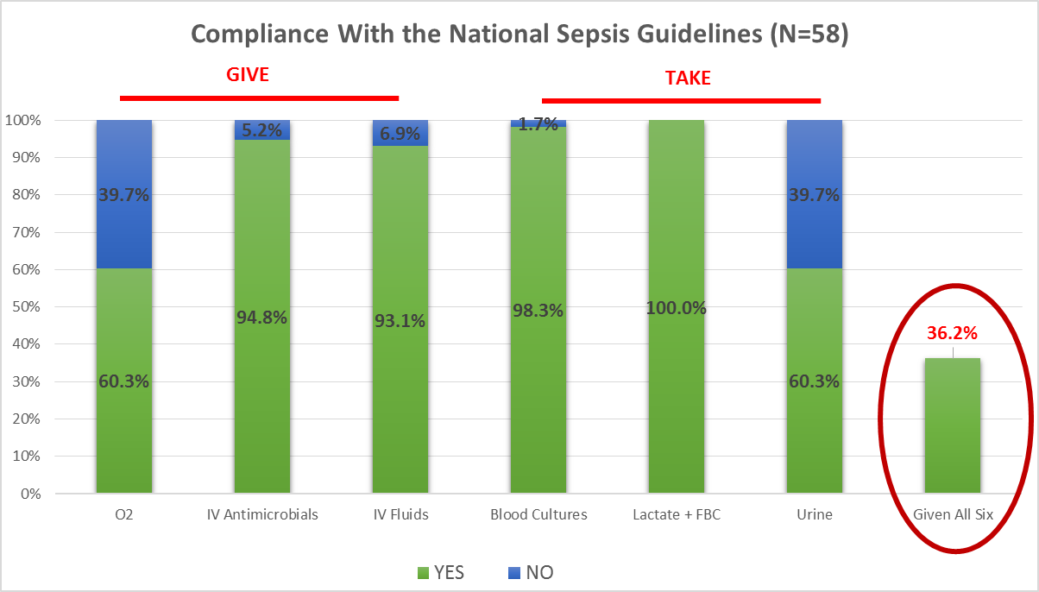
Overall Compliance
Compliance with giving all of the Sepsis 6 within 1 hour is 36.2%
This data includes all forms filled and scanned from Q1 2015 to Q2 2016 (inclusive)
We also had 100% compliance with taking Lactate & FBC overall
The two main areas to concentrate on are
Giving O2
Taking Urine

Slide 13
Changes Made From this Analysis
Laboratory – New Lactate machine added
Data from the lab shows an increase in the numbers of Lactates and Blood Cultures being carried out
Ongoing education to all staff
Compliance with the National Guidelines
Changed the Sepsis form to include time boxes

Slide 14
Future Plans
The presented results are process measures
Hoping to incorporate outcomes measures
Patient Outcomes
Length of Stay
Mortality
SOFA Score
Costing of Sepsis
Ongoing education to all staff
Establishing ‘Link Professionals’ in all departments
Encourage staff to be more proactive filling-in and scanning forms correctly

Slide 15
THANK YOU

