Slide 1

The challenges for SIRs & Sepsis data capture and reporting in ICD-10-AM in HIPE

Slide 2
What is Clinical Coding & HIPE?
Coding Sepsis & SIRs in HIPE
HIPE & The National Sepsis Programme
Notes:
.

Slide 3
What is Clinical Coding & HIPE?
Coding Sepsis & SIRs in HIPE
HIPE & The National Sepsis Programme
Notes:
.

Slide 4

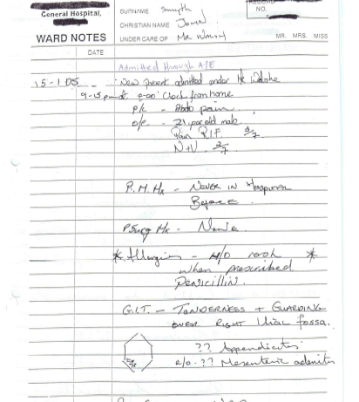
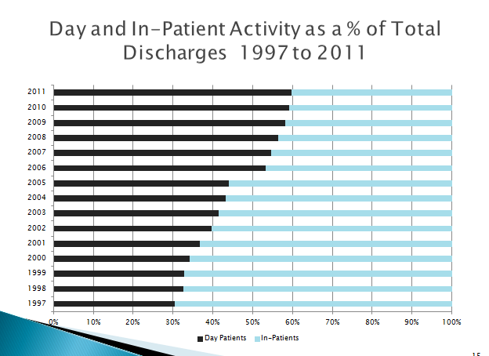
  The HIPE Clinical Coder translates the clinical documentation on a patient’s episode of care into standardised code

Slide 5
What is Clinical Coding?
the translation of medical terminology,
as written by the clinician
to describe a patient’s complaint, problem, diagnosis, treatment or reason for seeking medical attention,
into a coded format
which is nationally and internationally recognised.
Notes:
.

Slide 6

Accuracy is reliant upon…
The Clinician providing all the information on the patient’s diagnoses and treatment dated with signature.
The Clinical Coder translating that information into the appropriate coded format to reflect the patient’s hospital stay.

Slide 7

Who does the Clinical Coding?
Administration Staff
Trained and supported by the HPO and Hospitals
Critical link required between Clinical Staff and Clinical Coders
Notes:
.

Slide 8
  Entire patient record is the source document
  Clinical Notes
  Hospital information systems
  Discharge Summary
  Operation/Theatre information
  Histology reports
  Sepsis Form

Slide 9
  Hospital InPatient Enquiry (HIPE)
Activity data on Inpatient and Day cases in all HIPE Public hospitals in Ireland.
A HIPE discharge record is created when a patient is discharged from (or dies in) hospital
This contains administrative, demographic and clinical information for this episode of care.

Slide 10
Hospital Pricing Office (HPO) Supports
Training
Classification
Software – data entry / reporting
Audit / Data quality
Supporting documentation; ICS, Coding Notes
Support to hospitals & data users
Data request function

Slide 11






Discharge summary completed by physician
Coder extracts data from chart
Patient discharged from hospital
AUDIT
Training
Coder inputs data onto HIPE Portal
Data Quality
HIPE National Database
HPO
Monthly export to HPO
Local, National and International reporting
The HIPE Data Collection Process
Notes:
National file is used very quickly within the HSE – constantly requesting this quicker for ABF, Clinical Programmes etc.
We refresh the national file each month.
Data quality begins with the edits at data entry moving on to the checker, HCAT for auditing etc.
Data is constantly being checked – from clinical prog, hospital themselves, why so many of a certain procedure, why difference in this activity from year to year etc.

Slide 12
What is Clinical Coding & HIPE?
Coding Sepsis & SIRs in HIPE
HIPE & The National Sepsis Programme
Notes:
.

Slide 13

ICD-10-AM/ACHI/ACS 8th Edition
The International Statistical Classification of Diseases and Related Health Problems, Tenth Revision, Australian Modification (ICD-10-AM)
Incorporating the
Australian Classification of Health Interventions (ACHI)
& Australian Coding Standards (ACS)

Slide 14
ICD-10-AM/ACHI/ACS 8th Edition
Sepsis
R65 Systemic inflammatory response syndrome [SIRS]
    For use in multiple coding to identify SIRS resulting from any cause.
    A code from another chapter should be assigned first to indicate the cause or underlying disease.

Slide 15
ICD-10-AM/ACHI/ACS 8th Edition
SIRS/ Septic Shock
R65 Systemic inflammatory response syndrome [SIRS]
R65.0 Systemic inflammatory response syndrome [SIRS] of infectious origin without acute organ failure
R65.1 Systemic inflammatory response syndrome [SIRS] of infectious origin with acute organ failure Severe sepsis
R65.2 Systemic inflammatory response syndrome [SIRS] of noninfectious origin without acute organ failure
R57.2 Septic shock

Slide 16
ICD-10-AM/ACHI/ACS 8th Edition
Sepsis:
A40 Streptococcal sepsis
A41 Other sepsis
A02.1 Salmonella sepsis
A22.7 Anthrax sepsis
A26.7 Erysipelothrix sepsis
A32.7 Listerial sepsis
A42.7 Actinomycotic sepsis
B37.7 Candidal sepsis
T81.42 Sepsis following a procedure
R65.0 SIRS of infectious origin without acute organ failure
Severe Sepsis:
R65.1 Systemic inflammatory response syndrome [SIRS] of infectious origin with acute organ failure
Septic Shock:
R57.2 Septic shock

Slide 17
Sepsis can be coded
If there is documentation of Sepsis in the Medical Record
And/or
The Sepsis 6 form is completed and signed by the clinician
Notes:
Forms have been developed for roll out in Irish hospitals in 2015 by the National Clinical Effectiveness Committee
Refer participants to the form that is included in their folder

Slide 18
Sepsis is NOT coded if
The Sepsis 6 form is completed but not signed and Sepsis is not documented in the chart.
During the episode of care the patient is suspected of having Sepsis but Sepsis is ruled out before discharge.
Positive blood cultures are recorded in the absence of a clinical diagnosis of Sepsis.

Slide 19
  What clinical coders cannot do:
Second guess:
If there is any doubt about a diagnosis it cannot be coded
Wait:
  Coders must meet strict time deadlines to meet HSE requirements
Work alone:
They need clinical staff to collaborate

Slide 20
  Clinicians and Data Quality
The source documentation must:
  Be clear and detailed - writing clearly
  Provide accurate and complete information
  Clearly record all diagnoses including co-morbidities and procedures, writing the main diagnosis first
  Avoid abbreviations e.g. ‘M.S.’ could mean multiple sclerosis or mitral stenosis

Slide 21

  Clinicians and Data Quality:
  Meet the HIPE Coders regularly
    Understand their role
    Get to know each other

Slide 22
What is Clinical Coding & HIPE?
Coding Sepsis & SIRs in HIPE
HIPE & The National Sepsis Programme
Notes:
.

Slide 23

  National Sepsis Team & HIPE
Initial meetings to understand needs of both
Involvement in HIPE Coder training
  6 National Workshops
  250 coders attended
Links forged at hospital and national level.
  National Team
  Hospital Sepsis Teams
  Group Sepsis ADONs

Slide 24
  National Sepsis Team & HIPE
Trust and collaborative relationships built up.
Mutual respect for all in their roles
On-going collaboration and support

Slide 25
Deirdre.murphy@hpo.ie
www.hpo.ie
End

