Slide 1
The (Surviving) Sepsis Campaign at Cork University Hospital
www.survivingsepsis.org

Slide 2
The Surviving Sepsis Campaign SSC
Joint collaborative of the Society of Critical Care Medicine and European Society of Intensive Care Medicine
Its aim is to reduce mortality from Severe Sepsis worldwide

Slide 3
Sponsoring Organizations
American Association of Critical-care Nurses
American College of Chest Physicians
American College of Emergency Physicians
American Thoracic Society
Australian and New Zealand Intensive Care Society
European Society of Clinical Microbiology and Infectious Diseases
European Society of Intensive Care Medicine
European Respiratory Society
Infectious Disease Society of America
International Sepsis Forum
Society of Critical Care Medicine
Surgical Infection Society
Canadian Critical Care Society
Japanese Society of Critical Care Medicine
Japanese Association of Acute Medicine
German Sepsis Society
Latin American Sepsis Institute
Notes:
3

Slide 4
Why Participate in the SSC?
Participating hospitals have:
Access to free educational programs by world-renowned sepsis experts
Access to experienced, trained quality improvement experts
Access to colleagues at other institutions who share the commitment to improving care for patients with sepsis
Benchmarking: Access to the SSC database to enter your data and get reports on your performance
Notes:
4

Slide 5
Surviving Sepsis Campaign
Phase 1:
Barcelona Declaration (2002):
Reduce mortality from severe sepsis and septic shock by 25%
Phase 2:
Development of Evidence-based Guidelines (2004)
Second edition published 2008
Third edition released January 2013
Revised April 2015
Phase 3:
Education and Implementation
Development of Sepsis Bundles
Notes:
5

Slide 6
Surviving Sepsis Campaign Phase 3
Partner with Institute for Healthcare Improvement (IHI)
Facilitate adoption of guidelines
Benchmark performance
Notes:
6

Slide 7
The SSC Guidelines Initial Bundle
Measure lactate level
Obtain blood cultures prior to administration of antibiotics
Administer broad spectrum antibiotics 4
Administer 30ml/kg crystalloid for hypotension or lactate ≥4mmol/L

Slide 8
The SSC Guidelines 6 hour Bundle
In the event of persistent hypotension after initial fluid administration (MAP < 65 mm Hg) or if initial lactate was ≥4 mmol/L, re-assess volume status and tissue perfusion and document findings
Apply vasopressors (for hypotension that does not respond to initial fluid resuscitation) to maintain a mean arterial pressure (MAP) ≥65mmHg 6.
Re-measure lactate if initial lactate elevated.

Slide 9
The SCC Guidelines Reassessment of fluid status
EITHER
Repeat focused exam (after initial fluid resuscitation) by licensed independent practitioner including vital signs, cardiopulmonary, capillary refill, pulse, and skin findings.
OR TWO OF THE FOLLOWING:
CVP
ScvO2
Bedside cardiovascular ultrasound
Dynamic assessment of fluid responsiveness with passive leg raise or fluid challenge

Slide 10
Surviving Sepsis Campaign Phase 3: Results
252 sites in 18 countries
15,775 subjects
Sites entered patients from 1 to 37 months
Levy MM et al. CCM 38(2):367-374, February 2010.
Notes:
10

Slide 11
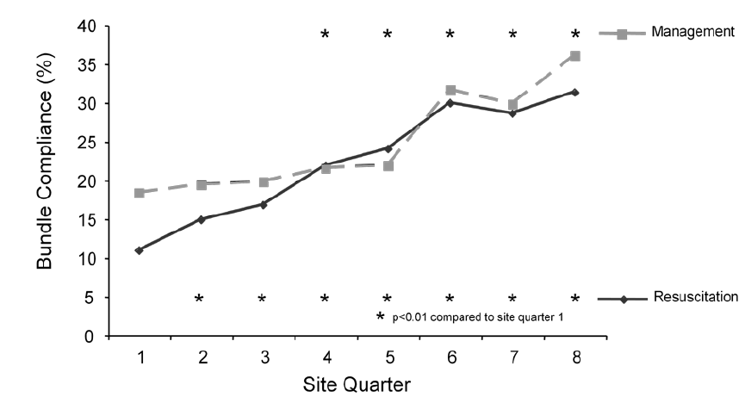
Change in Compliance Over Time
Levy MM et al. CCM 38(2):367-374, February 2010.
Notes:
11

Slide 12
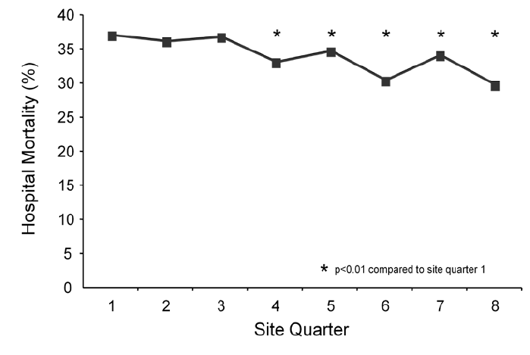
Change in Mortality Over Time
Levy MM et al. CCM 38(2):367-374, February 2010.
Notes:
12

Slide 13
Longer Term Results
Hospitals with 3 and 4 year participation in the SSC showed continued improvement over the entire period of participation
No plateau seen in benefit
Compliance with bundles continued to increase
Hospital mortality continued to decrease
Data in publication

Slide 14
SSC: The Next Phase
Increase the number of hospitals contributing data to the Surviving Sepsis Campaign to 10,000 worldwide
Apply the guidelines to 100% of patients in whom the diagnosis is suspected
Develop a strategy to improve the care of septic patients where healthcare resources are limited

Slide 15
SSC: The Next Phase
Assuming that the reduction in mortality seen to date can be sustained and 10,000 hospitals comply with the Campaign recommendations, 400,000 lives could be saved if even only half of the eligible patients were treated with the Surviving Sepsis Campaign Bundles

Slide 16
Surviving Sepsis
Implementation
Cork University Hospital

Slide 17
Surviving Sepsis- the IHI model
Learn about quality improvement in sepsis
Establish a baseline- start by collecting data before formal improvements e.g. collect data on sepsis patients in the ICU
Ask for administrative buy –in and form a team
Develop an institution specific protocol that includes the bundles/screening tool to identify patients
Educate staff on the floor
Recount success and remediate errors through monthly feedback from the SSC database

Slide 18
Forming the Team
Aim: Start with ED to implement best possible care for septic patients, using the known evidence with a view to rolling out to the rest of the hospital
Core Leadership Team: The Deteriorating Patient Governance Group
The leadership team is interdisciplinary reports to the Hospital Quality and Safety Committee – Executuve Management Board
Critical care medicine physician
ED physician
Clinical Educator
Risk Manager
ED nurse facilitator
ED nurse manager
ED charge/triage nurse
Sepsis Lead Nurse
Others….NCHDs

Slide 19
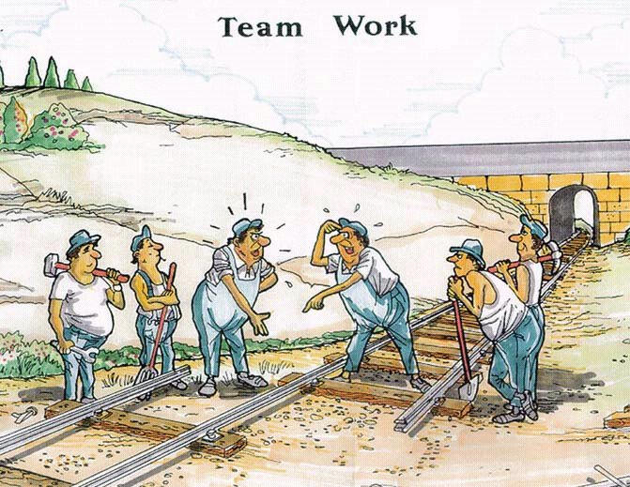
Role of Collaboration
ICU
ED
19

Slide 20
Sepsis- 10 point plan
The team –multidisciplinary ED/ICU nursing and medical/enthusiasts/front line workers √
Develop a screening tool and management bundle protocol based on guidelines- distribute to all even the naysayers√
Education sessions- interdisciplinary where possible. On the floor, grand rounds, undergraduate, launch √
Collect the data- start small- Patients admitted with severe sepsis from the ED to ICU. Set an achievable goal √

Slide 21
Sepsis 10 point plan
5. Notify administration of the project √
6. Collaboration -team meetings focused on change (keep it short!), use results of data to drive change (PDSA). Keep it small at first √
7. Notify all stakeholders of even small success√
8. Bring results and successes to administration to gain further support
9. Build the improvement process stepwise to other bundle components of sepsis care
10 The hospital floor…..

Slide 24
Challenges….
Other areas of the hospital
Feedback on a case by case basis
NCHD engagement
Ongoing education
Signing of sepsis screening forms
Resources
The honeymoon problem

Slide 25
Positives…
Visible successes
Wider patient care issues out in the open
Engagement with hospital management
The level of commitment from staff to improve patient care
THANK YOU

