Slide 1
Implementation of National Clinical Guideline No 6: Sepsis Management Roscommon University Hospital
Ms. Anne Scahill, CNM2, Training Officer
Ms. Caitriona Rayner, CNM2, Medical Assessment Unit & Injuries Unit

Slide 2
What is Sepsis?:
“ Sepsis is a life threatening condition that arises when the body’s response to an infection injures its own tissues and organs. Sepsis leads to shock, multiple organ failure and death, especially if not recognised early and treated promptly. Sepsis remains the primary cause of death from infection despite advances in modern medicine, including vaccines, antibiotics and acute care. Millions of people die of sepsis every year worldwide.”
Merinoff Symposium 2010: Sepsis

Slide 3
Background:
2016 was identified as the year for the implementation of the National Clinical Guideline in Sepsis Management.
The Sepsis Screening Tool is a clinical decision making tool to standardise practice and to aid the early detection of sepsis, sever sepsis and/or septic shock.
Medical Assessment Units are ideal clinical environments to introduce
the sepsis screening tool as it promotes rapid assessment, supports swift
clinical decision making and timely treatments.

Slide 4
Background (Contd):
52% of the patients admitted to RUH are admitted via the Medical
Assessment Unit (MAU), therefore it was agreed to commence education and implementation of the Sepsis Screening Tool in the MAU and subsequently roll out to all staff

Slide 5
Objectives:
Timely management of patients with suspected Sepsis.
Ensure Sepsis Screening form is commenced if infection is suspected.
Educate the interdisciplinary team on Sepsis and Sepsis Management.
Audit and evaluate outcome of Implementation of Clinical Guideline No 6.
Sepsis box available in all clinical areas, launched on World Sepsis Day, 13th September 2016.

Slide 6
Implementation of the Sepsis Screening Programme in RUH:

Slide 7
Governance Established
Saolta Sepsis Steering Group Convened
Interdisciplinary Meetings and Education
Introduction of Screening From
Link Staff Identified
National Sepsis Lead and Saolta ADoN Sepsis Presentations and Support
Introduction of Sepsis Screening Box (NMPDU funded)
Registration Log Established in MAU/IU for Suspected Sepsis
Introduction for Colour Sepsis Magnet (Productive Ward)
Gap Analysis/Action Plan Post 1st Sepsis Audit
Public Sepsis Awareness Questionnaire Completed.
World Sepsis Day – 13th Sept, 2016 Awareness Drive

Slide 8
Governance:
The governance for the sepsis programme and its implementation at RUH is provided by our Resuscitation Committee which incorporates Clinical Guideline No 6. There is local involvement and guidance from the Infection Control and Prevention Team.
The Medical and Nursing leads were identified and agreed.
Link staff identified for each clinical areas.
Close links with Saolta Group Sepsis ADoN including regular meetings and education sessions.
The Saolta Sepsis Steering Group were convened.

Slide 9
Schedule of Meeting and Education Sessions were Provided for Inter-Disciplinary Teams
Education Roll Out
MAU
St. Coman’s Ward
St. Bridget’s Ward
All other clinical areas
Management Team
NCHD Education Sessions
Notes:
Could we put in :Link staff identified for each clinical areas.
National Sepis Lead and Saolta ADoN Sepsis Presentations and Support on this slide please Susan??

Slide 10
Sepsis Screening Form was Introduced to Clinical Areas
Notes:
Add picture of Screening form and EWS? Ann have you a better picture?

Slide 11
Medical Assessment Unit
Registration log introduced into MAU/IU to record patients with suspected sepsis.
Trial and implementation of sepsis box in MAU/IU.
Patients are identified on Productive Ward Board with colour coded sepsis magnet

Slide 12
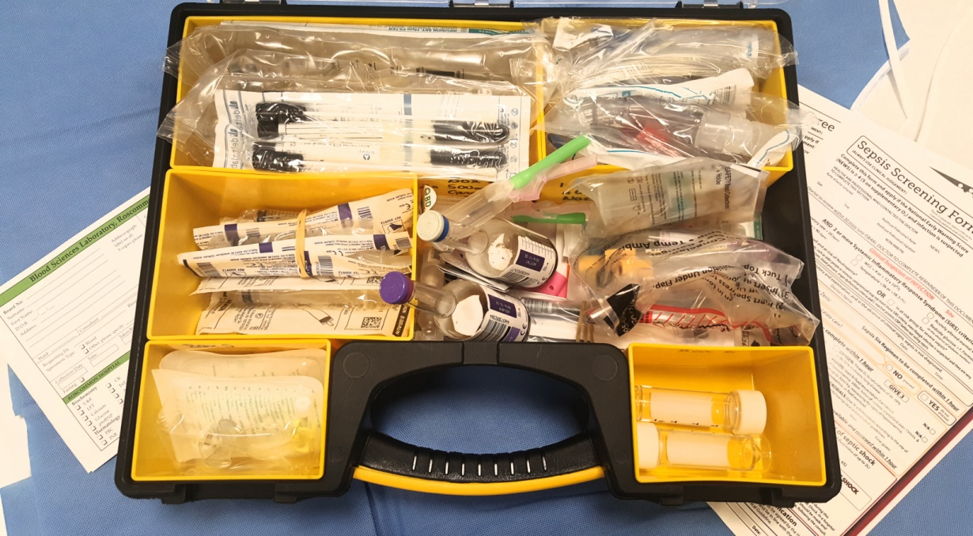
Sepsis Screening Box
Funding granted by the NMPDU for designated sepsis screening boxes in individual areas.
Notes:
Add picture of Screening form and EWS? Ann have you a better picture?

Slide 13
Implementation:
Implementation of sepsis box in all clinical areas.
Information disseminated to Management Team, Heads of Departments, Quality and Risk Committee, Professional Practice Committee, Nurses Forum and all other meetings.
Support from Laboratory and Nursing Administration to assist in reporting blood cultures/lactates and other markers in Sepsis identification.
Gap analysis completed/Action plan completed following first Sepsis audit.
RUH staff involved in the completion of the Sepsis Awareness Questionnaire for the next phase of the Sepsis Implementation Programme in 2017.

Slide 14
Sepsis Audit:
1st Sepsis Audit completed in April, 2016
Gap Analysis /Action Plan followed same
2nd Sepsis Audit completed in July, 2016 and findings currently awaited
Education ongoing

Slide 15
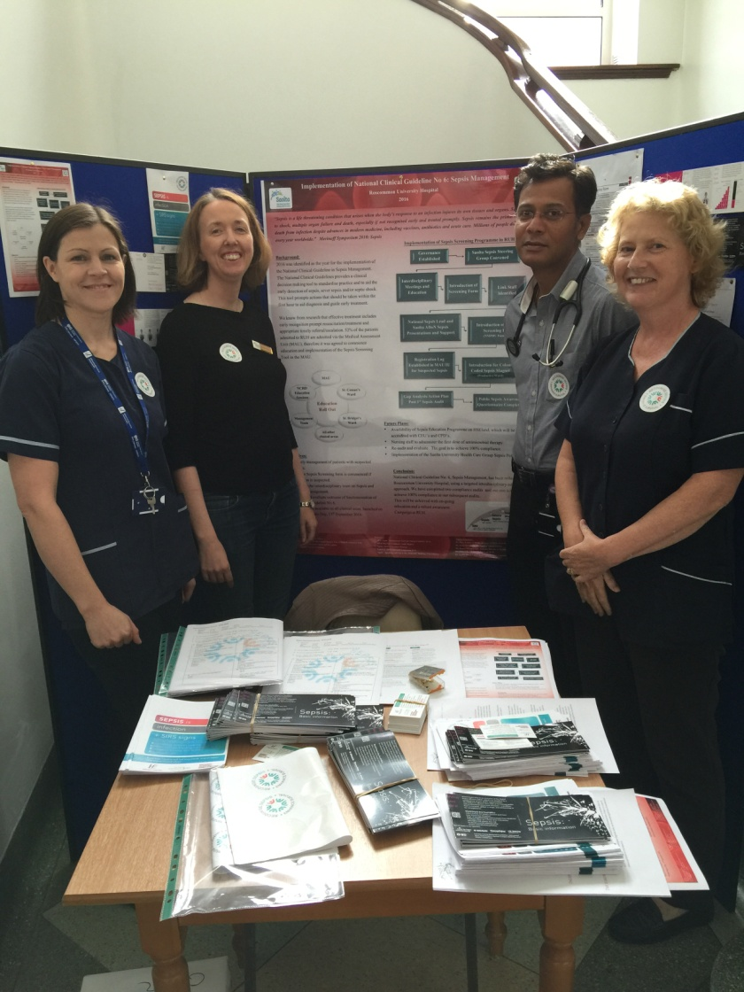
World Sepsis Day:
RUH hosted an awareness drive for all staff, patients and visitors
on 13th September, 2016.

Slide 16
Future Plans:
Availability of Sepsis Education Programme on HSEland, which will be accredited with CEU’s and CPD’s.
Nursing staff to administer the first dose of antimicrobial therapy.
Re-audit and evaluate. The goal is to achieve 100% compliance.
Implementation of the Saolta University Health Care Group Sepsis Policy

Slide 17
Conclusion:
National Clinical Guideline No: 6, Sepsis Management, has been rolled out at Roscommon University Hospital, using a targeted interdisciplinary education approach.
We have completed two compliance audits and our aim is to achieve 100% compliance in our subsequent audits. This will be achieved with on-going education and a robust awareness campaign at RUH.

