Slide 1
My Sepsis Experience
By Brian Mac Intyre
October 2013 - April 2014

Slide 2
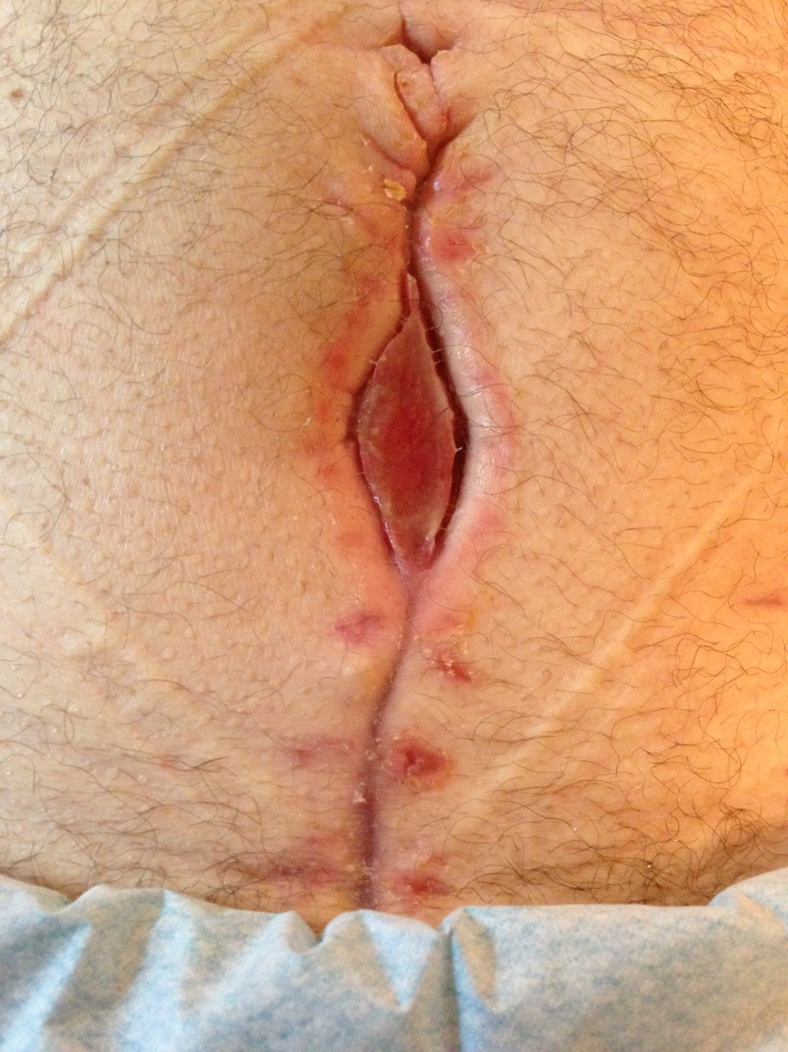
About
5 weeks
post-op

Slide 3
Hernia Caused
by Sepsis
5 Months
Post-op
(front view)

Slide 4
Hernia Caused
by Sepsis
5 Months
Post-op
(SIDE view)

Slide 5
Post-Hernia Surgery
6 months after op
to repair bowel

