Slide 1
UL Hospitals Group
Breda Fallon,
Assistant Director of Nursing, Group Sepsis Lead.

Slide 2
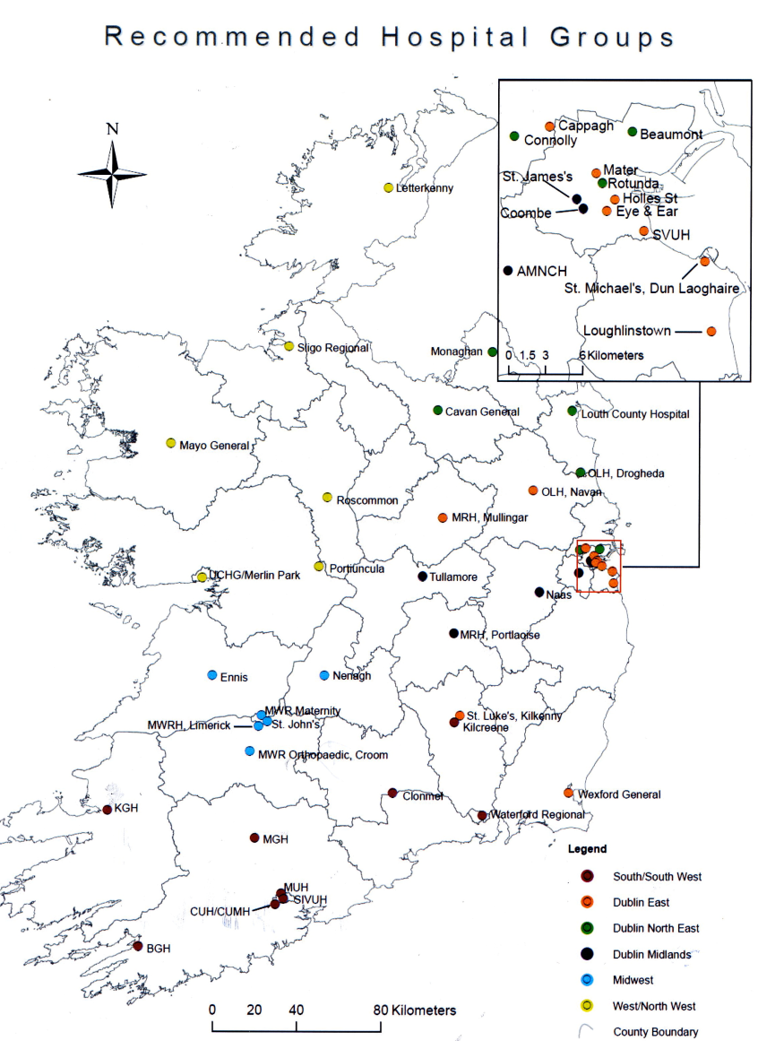
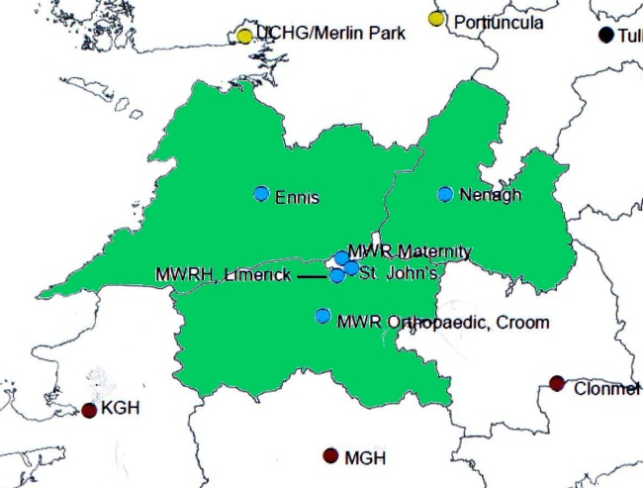
Development of UL Hospitals Group
Higgins’ Report 2013
Counties - Limerick, Clare and North Tipperary
Population – 379,327
Academic Partner: University of Limerick
Notes:
A national reorganisation of acute hospital services in 2013 brought about the formation of UL Hospitals Group, the first of seven hospital groups in the country to be established with UL as its strategic partner. UL Hospitals comprises University Hospital Limerick, University Maternity Hospital, Limerick, Ennis Hospital, Nenagh Hospital, Croom Hospital and St. John’s Hospital.

Slide 3
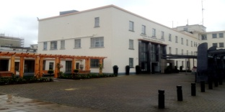
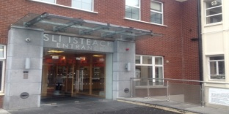
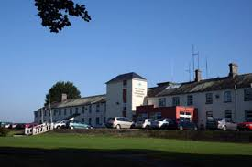
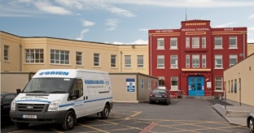
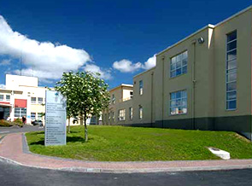
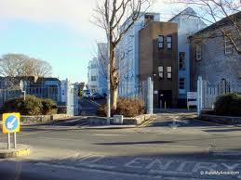
UL Hospitals Group Overview
 | Hospital | Model | Beds | Staff
 | University Hospital Limerick | 4 | 320 in-patient 81 day beds | 1,942
 | University Maternity Hospital | Speciality | 83 in-patient 19 neo-natal | 294
 | Croom Hospital | Speciality | 37 in-patient 13 day beds | 144
 | Ennis Hospital | 2 | 50 in-patient 16 day beds | 206
 | Nenagh Hospital | 2 | 49 in-patient 25 day beds | 179
 | St. John’s Hospital | 2 Surgical | 89 Adult 10 day beds | 268
Notes:
UL hospitals is a group of six hospitals in the Mid-West that offer a range of services – from accident and emergency departments and cancer and maternity care to inpatient and outpatient services, orthopedic services, and medical assessment. All the hospitals are run together to form a single hospital system across the six sites.
UL Hospitals serve a population of some 400,000 people and its six clinical sites collectively, working as a single hospital system, provide about 750 acute hospital beds, delivering a comprehensive range of acute in-patient and ambulatory care services. The range and the level of sophistication of services provided has improved significantly in recent years. Many of the specialist and sub-specialist services provided at UL Hospitals are at least on a par with the country’s best. However, UL Hospitals’ greatest asset is undoubtedly its 3,000-strong dedicated and highly professionalised workforce.

Slide 4
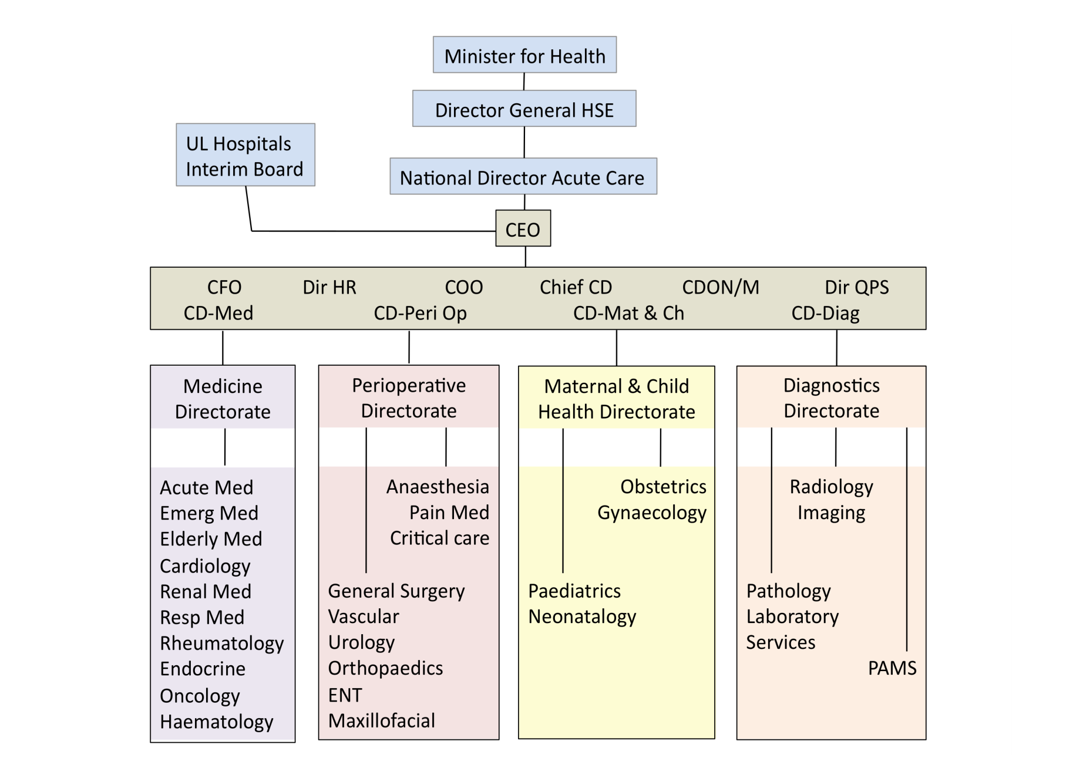
Governance of UL Hospitals Group
External
Executive
Clinical Director
Directorate Manager
Directorate Nurse Managers
Business Manager
QPS Manager
Accountant
Directorates

Slide 5
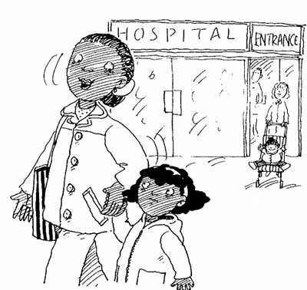
UL Hospitals Group
Going Forward
Notes:
Plan do check act, small cycles of change across the hospital group,
National project

Slide 6
UL Hospitals Group
Thank you

