Slide 1
Karen Harris
Consultant in Emergency Medicine
Chair of Sepsis Local Implementation Group

Slide 3
Sepsis LIG
Chair: Consultant in Emergency Medicine
Lead: Assistant Director of Nursing, Infection Prevention and Control
Members:
Resuscitation Training Officer
Interim Director of Nursing & Midwifery
Assistant Director of Nursing – Critical Care and Unscheduled Care
Assistant General Manager
Consultant Microbiologist
Chief Pharmacist
Antimicrobial pharmacist
Consultant Anaesthetist
CNM III Medical
Clinical Audit Facilitator

Slide 4
Sepsis LIG
HIPE co-ordinator
Laboratory manager

Slide 6
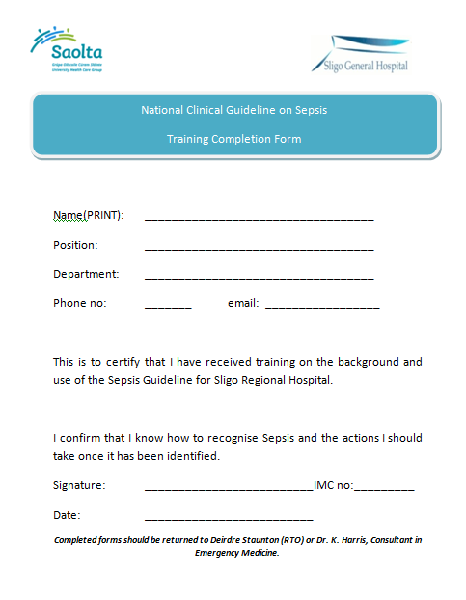

Slide 7
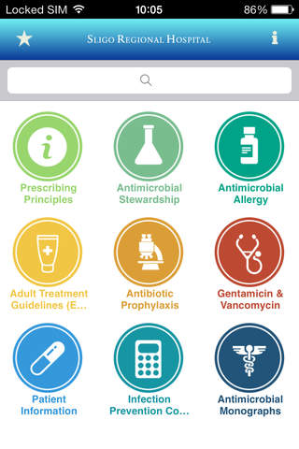
Sligo Regional Hospital Antimicrobial Prescribing Guide (SHARx)

Slide 14
