Slide 1
REFLECT
RECOVER
RENEW
COVID-19 Team Reflection
“Learning together from our shared experiences”
Notes:
Facilitator notes:
Opening slide to the team session.
The slides that follow (slides 2-4) support team contracting in the session – ground rules for participation and respect.
The slides that follow (slides 5-6) provide information on the Health Services Change Guide and the context of Reflect Recover Renew as a team reflection resource in this COVID-19 era.

Slide 2
Welcome………
This slide can be used to set out how you will work together as a team during the session. This will be influenced by the setting i.e. virtual or face to face.
Ground rules for engagement
Confidentiality
Times and breaks etc.
Notes:
Facilitator notes:
Opening slide to the team session.
The slides that follow (slides 2-4) support team contracting in the session – ground rules for participation and respect.
The slides that follow (slides 5-6) provide information on the Health Services Change Guide and the context of Reflect Recover Renew as a team reflection resource in this COVID-19 era.

Slide 3
Reflect Recover Renew Purpose of our team session
Opportunity to reflect on learning & share experiences during COVID-19
Reflect on what you did, Recover what is relevant, Renew what is sustainable as a team.
Consider how we move forward in a changed context.
Using the Health Services Change Guide ‘Reflect Recover Renew’ team resources.
Source of materials: People’s Needs Defining Change - Health Services Change Guide
Notes:
Facilitator notes:
Purpose of our team session
Opportunity to reflect on learning & share experiences during COVID-19
Reflect on what you did, Recover what is relevant, Renew what is sustainable as a team.
Consider how we move forward in a changed context.
Using the Health Services Change Guide ‘Reflect Recover Renew’ team resources.
Source of materials: People’s Needs Defining Change - Health Services Change Guide

Slide 4
Notes:
Facilitator notes:
This slide connects you to the Change Guide and how it can help teams navigate rapid emergent change:
Good change practices are critical right now to help us benefit from the rapid pace of change and innovation.
‘Disruption’ is a positive force for change – it requires personal and team agility to make sense of it.
The Change Guide helps us understand our experiences, balance stability with change and continue to re-design a better health service.
(You might find it helpful to review the Change Guide before the team session on www/hse.ie/changeguide/covid19-teamresources or complete the eLearning programme for the Change Guide on HSELanD – Delivering Change in Health Services as support to the session)

Slide 5
Health Services
Change Guide
Supports teams by building
capacity, skills and confidence
to deliver change and innovation
in healthcare using the
Change Guide Framework.
Notes:
Facilitator notes:
The Health Services Change Guide supports teams by building capacity, skills and confidence to deliver change and innovation in healthcare using the Change Guide Framework.

Slide 6
Notes:
Facilitator notes:
This slide introduces the Change Framework signalling it as a resource for creating readiness and the conditions for change using the People and Culture Change Platform.

Slide 7
Notes:
Facilitator notes:
This slides introduces ‘Reflect Recover Renew’ as a resource to help teams pause and reflect on their experiences of COVID-19 and gather the learning to support recovery and renewal together.

Slide 8
This session will help us to use the Change Guide team reflection resources ‘Reflect Recover Renew’ to:
Take time with colleagues to pause and reflect.
Consider the learning and make sense of our experiences during COVID-19.
Identify what individual and team supports are needed.
Plan for how services can be resumed or redesigned.
Consider how new practices can be implemented.
Build on new relationships to sustain improvements.
Notes:
Facilitator Notes:
This slide addresses how the team can now engage with the Change Guide and associated ‘Reflect Recover Renew’ resources.
This session will help us to use the Change Guide team reflection resources ‘Reflect Recover Renew’ to:
Take time with as colleagues to pause and reflect.
Consider the learning and make sense of our experiences during COVID-19.
Identify what individual and team supports are needed.
Plan for how services can be resumed or redesigned.
Consider how new practices can be implemented.
Build on new relationships to sustain improvements.

Slide 9
Introducing
Reflect
Recover
Renew
Reflect sensitively
Recover with kindness
Renew with hope

Slide 10
Notes:
Facilitator Notes:
Setting the context around the need to pause and reflect as a team.
COVID-19 has had a profound impact on people personally, their families, work colleagues and communities.
It is important that we acknowledge these reactions and experiences sensitively and take time to learn from what has happened together.
Value a shared sense of purpose - to protect the health of our population. We can build on this common strength to adapt and improve our ways of working.

Slide 11
Notes:
Facilitator Notes:
Pressures are significant and well beyond anything we have experienced previously.
Let's learn as a team from what we have achieved and blend this with future possibilities – helping us build a better future.
Taking time to notice the things that are ‘new’.
Value the experiences to shape how services need to evolve and how our team can be supported.

Slide 12
What do we need to support our team conversation and reflection?
Review the "Reflect Recover Renew – Making Sense of Rapid Emergent Change" team template and agree how we will facilitate the team conversation together.
Agree how best to create a reflective/learning culture – a safe place to share insights, concerns and hopes based on our experiences of COVID-19.
Identify who will coordinate the learning efforts – agree ways to make it easy to gather and share insights given existing pressures on the team.
Notes:
Facilitator Notes:
This slide and the next begins to open up the team engagement to support conversations and reflection – setting out the actions and team behaviours for working together.
What do we need to support our team conversation and reflection?
• Review the "Reflect Recover Renew – Making Sense of Rapid Emergent Change" team template and agree how you will facilitate the team conversation together. • Agree how best to create a reflective/learning culture – a safe place to share insights, concerns and hopes based on your experiences of COVID-19. • Identify who will coordinate the learning efforts – agree ways to make it easy to gather and share insights given existing pressures on the team. • Agree what information you want to collect using the questions in the template as a starting point. • Identify how you will come together to share and act on the learning – i.e. ‘on the go’, team huddles, learning sessions. • Agree how you will share the learning with senior colleagues and put an action plan in place.

Slide 13
What do we need to support our team conversation and reflection?
Agree what information we want to collect using the questions in the template as a starting point.
Identify how we will come together to share and act on the learning – i.e. ‘on the go’, team huddles, learning sessions.
Agree how we will share the learning with senior colleagues and put an action plan in place.
Notes:
Facilitator Notes:
This slide and the previous slide begin address team engagement to support conversations and reflection – setting out the actions and team behaviours for working together.
What do we need to support our team conversation and reflection?
• Review the "Reflect Recover Renew – Making Sense of Rapid Emergent Change" team template and agree how you will facilitate the team conversation together. • Agree how best to create a reflective/learning culture – a safe place to share insights, concerns and hopes based on your experiences of COVID-19. • Identify who will coordinate the learning efforts – agree ways to make it easy to gather and share insights given existing pressures on the team. • Agree what information you want to collect using the questions in the template as a starting point. • Identify how you will come together to share and act on the learning – i.e. ‘on the go’, team huddles, learning sessions. • Agree how you will share the learning with senior colleagues and put an action plan in place.

Slide 14
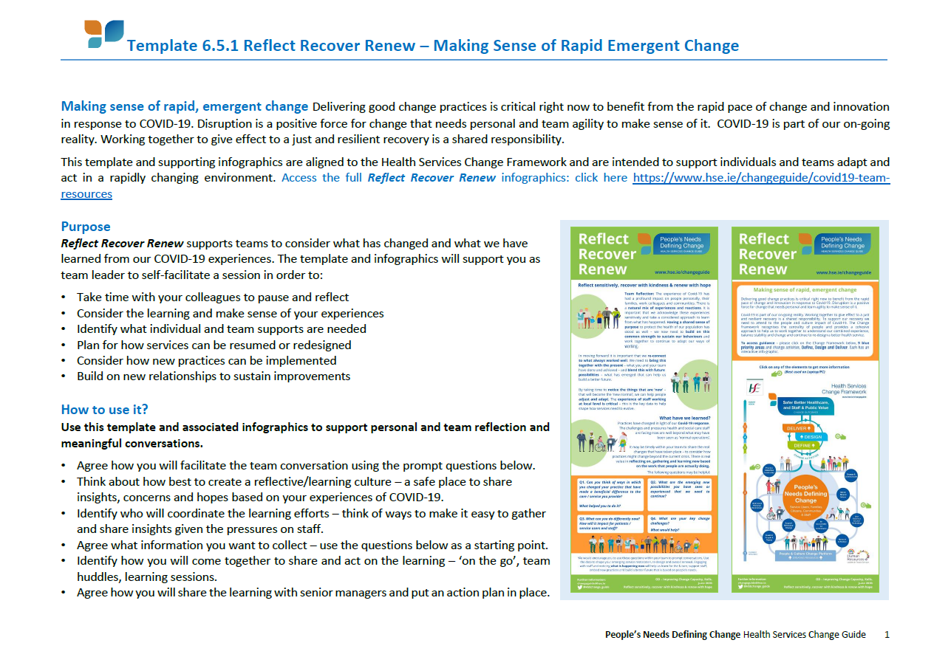
Notes:
Facilitator Notes:
This is the first introduction to Template 6.5.1: Reflect Recover Renew - Making Sense of Rapid Emergent Change and the associated team reflection questions
The team ideally will have a hard or soft copy available to them for the session. You can confirm this is the Template you will be working through as a team in a few moments.
This Template sets out information on:
Making sense of rapid, emergent change
Delivering good change practices is critical right now to benefit from the rapid pace of change and innovation in response to COVID-19.
Disruption is a positive force for change that needs personal and team agility to make sense of it.
COVID-19 is part of our on-going reality.
Working together to give effect to a just and resilient recovery is a shared responsibility.
The template and supporting infographics are aligned to the Health Services Change Framework and are intended to support individuals and teams adapt and act in a rapidly changing environment.
(To access the full Reflect Recover Renew infographics: click here https://www.hse.ie/changeguide/covid19-team-resources)
Purpose (covered in slide 6)
Reflect Recover Renew supports teams to consider what has changed and what we have learned from our COVID-19 experiences. The template and infographics will support you as team to self-facilitate a session in order to:
Take time with your colleagues to pause and reflect
Consider the learning and make sense of your experiences
Identify what individual and team supports are needed
Plan for how services can be resumed or redesigned
Consider how new practices can be implemented
Build on new relationships to sustain improvements
How to use it? (Covered in slide 10 & 11)
Use this template and associated infographics to support personal and team reflection and meaningful conversations.
Agree how you will facilitate the team conversation using the prompt questions below.
Think about how best to create a reflective/learning culture – a safe place to share insights, concerns and hopes based on your experiences of COVID-19.
Identify who will coordinate the learning efforts – think of ways to make it easy to gather and share insights given the pressures on staff.
Agree what information you want to collect – use the questions below as a starting point.
Identify how you will come together to share and act on the learning – ‘on the go’, team huddles, learning sessions.
Agree how you will share the learning with senior managers and put an action plan in place.

Slide 15
Notes:
Facilitator Notes;
The next 4 slides reflect the questions set out in page 2 of Template 6.5.1: Reflect Recover Renew - Making Sense of Rapid Emergent Change
Go through the 4 slides to introduce the questions to the team before the activity of sharing and gathering data using the Template as a prompt. Alternatively you could pause with each question and gather the data as you move along - think about how the data will be gathered and perhaps agree in advance who will record the key messages.

Slide 16
Notes:
Facilitator Notes:
Q. Can you think of ways in which you changed your practice* that improved the care and service you provide? Q. What helped you to do it?
*New roles, working relationships, skills, technology, work practices, working in different locations etc.

Slide 17
Notes:
Facilitator Notes:
What are the emerging possibilities you have seen or experienced that we need to continue?

Slide 18
Notes:
Facilitator Notes:
What can you as a team do differently now? How will these changes impact for patients/services users and for staff?

Slide 19
Notes:
Facilitator Notes:
What are your key change challenges? What would help to address these challenges?

Slide 20
Template 6.5.1: Reflect Recover Renew - Making Sense of Rapid Emergent Change
Notes:
Facilitator Notes:
The next 2 slides will have the Template displayed to assist in you and your team going through the questions together.
For a virtual session you may find it helpful to bring the word version of the Template onto the screen and complete it as you work together.
For a face to face team session you may wish to use flip charts, sticky notes and other creative tools to help gather the data.

Slide 21
Template 6.5.1: Reflect Recover Renew - Making Sense of Rapid Emergent Change

Slide 22
Notes:
Facilitator Notes:
On the right you will see the Health Services Change Framework. What is the Health Services Change Framework?
The Change Framework brings together all the elements you need to focus on to deliver change. The change outcomes are safer better healthcare and services that are valued by the public and by staff.
It places People’s Needs Defining Change at the centre of all change initiatives.
It recognises that change is essentially about people.
It prioritises engagement – ‘people support the change they help to create’.
It focuses on a People and Culture Change Platform to prepare an environment where change can be encouraged and developed.
It provides guidance on the change activities:
-Define what needs to change and clarify why
-Design a better future with all key people involved
-Deliver and sustain the change
The Change Framework has 9 priority areas and 3 change activities - Define, Design and Deliver
Each has an interactive infographic with guidance and links to tools from the Change Guide.
It may be useful for the team to consider:
What needs have emerged from completing Template 6.5.1?
What priority areas or change activities are a priority right now that you need to attend to?

Slide 23
Template 6.5.1: Reflect Recover Renew - Making Sense of Rapid Emergent Change
Notes:
Facilitator Notes:
It might be helpful to have some of the infographics open from the HSE website (https://www.hse.ie/eng/staff/resources/changeguide/covid19-team-resources/ ) so you can access the hyperlinks to specific tools referenced from the Change Guide to support team discussion.
This slide reveals infographics for:
Understand Personal Experiences
Support Behaviour Change
Practice Collective Leadership
Model Shared Values
You can see each one sets out (1) the key to recovery and renewal, (2) how you can act and adapt to support that recovery and (3) tips and tools to enable teams to deliver good change and innovation.

Slide 24
Template 6.5.1: Reflect Recover Renew - Making Sense of Rapid Emergent Change
Notes:
Facilitator Notes:
This slide reveals infographics for:
Engage and Communicate
Invest in People and Teams
Network and Partner
Use Evidence and Lever Technology
You can see each one sets out (1) the key to recovery and renewal, (2) how you can act and adapt to support that recovery and (3) tips and tools to enable teams to deliver good change and innovation.

Slide 25
Template 6.5.1: Reflect Recover Renew - Making Sense of Rapid Emergent Change
Notes:
Facilitator Notes:
This slide reveals infographics for:
Deliver Public Value and Be Accountable
Define
Design
Deliver
You can see each one sets out (1) the key to recovery and renewal, (2) how you can act and adapt to support that recovery and (3) tips and tools to enable teams to deliver good change and innovation.

Slide 26
This side can be used to ‘close out’ your team session and recap on what was shared and next steps/actions as a team.
Notes:
Facilitator Notes:
This side can be used to close out your team session and recap on what was shared and next steps/actions as a team.

Slide 27
Notes:
Facilitator Notes:
This slide is a reminder of how to access ‘Reflect Recover Renew’ resources.

